Slide 1
Lecture 5
Operating Systems (COMP1562)

Slide 2

Generic Scheduling Criteria/Aim of Scheduling
Batch systems
Processor utilisation
Throughput (number of processes completed within a time unit)
Interactive systems
Response time
Real-Time Systems
Deadlines
Predictability
Mariusz Pelc © 2012/2013
(with support from Dr K. McManus and Dr C. Ierotheou)

Slide 3
Scheduling - types
Scheduling - is the process of deciding how to commit resources between a variety of possible/running tasks (processes). Scheduling is supervised by a special system process called scheduler.
There are three types of schedulers:
Short Term Scheduler (SSch) is responsible for allocation of processor to ready processes
Medium Term Scheduler (MSch) is responsible for processes exchange between main and external mamory (i.e. Hard drive)
Long Term Scheduler (LSch) – responsible for loading new programs into memory, control of number of tasks in the system as well as balancing resource usage by tasks selection
I/O Scheduler – responsible for managing process I/O requests
Mariusz Pelc © 2012/2013
(with support from Dr K. McManus and Dr C. Ierotheou)

Slide 4
Levels of scheduling
Running
Short-Term Scheduler
Ready
Blocked
Medium-Term Scheduler
Blocked
Suspended
Long-Term Scheduler
Ready
Suspended
New
Exit
Mariusz Pelc © 2012/2013
(with support from Dr K. McManus and Dr C. Ierotheou)

Slide 5
Medium-Term Scheduling
Part of the swapping function in the virtual memory system
Based on the need to manage the degree of multiprogramming
Mariusz Pelc © 2012/2013
(with support from Dr K. McManus and Dr C. Ierotheou)

Slide 6
Long-Term Scheduling
Determines which programs are admitted to the system for processing
Controls the degree of multitasking
More processes, smaller percentage of time each process is executed
Mariusz Pelc © 2012/2013
(with support from Dr K. McManus and Dr C. Ierotheou)

Slide 7
Short-Term Scheduling
Known as the dispatcher
Executes frequently
Invoked when an event occurs
Clock interrupts
I/O interrupts
Operating system calls
Signals
Mariusz Pelc © 2012/2013
(with support from Dr K. McManus and Dr C. Ierotheou)

Slide 8
Short-Term Scheduling - Criteria
User-oriented
Response Time
Elapsed time between the submission of a request until there is output.
System-oriented
Effective and efficient utilization of the processor
Mariusz Pelc © 2012/2013
(with support from Dr K. McManus and Dr C. Ierotheou)

Slide 9
Short-Term Scheduling
Performance-related
Quantitative
Measurable such as response time and throughput
Not performance related
Qualitative
Predictability
Mariusz Pelc © 2012/2013
(with support from Dr K. McManus and Dr C. Ierotheou)

Slide 10
Priorities
Scheduler will always choose a process of higher priority over one of lower priority
Have multiple ready queues to represent each level of priority
Lower-priority may suffer starvation
allow a process to change its priority based on its age or execution history
Mariusz Pelc © 2012/2013
(with support from Dr K. McManus and Dr C. Ierotheou)

Slide 11
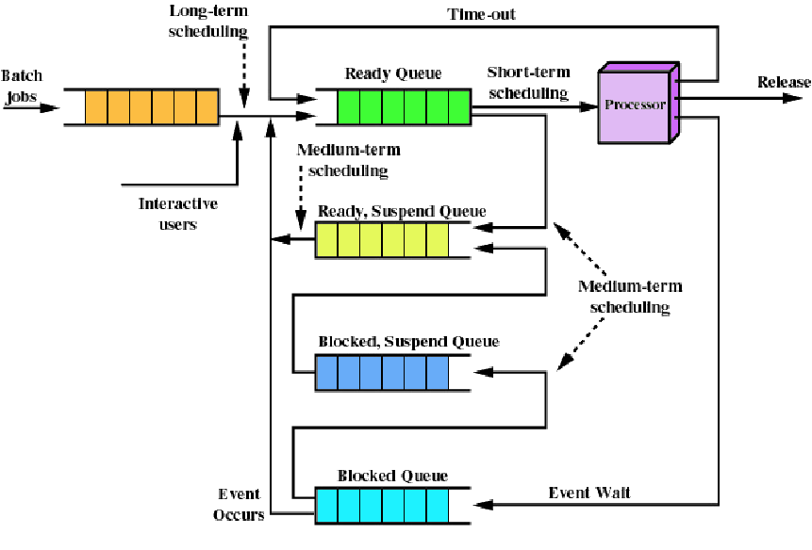
Queuing for Scheduling
Mariusz Pelc © 2012/2013
(with support from Dr K. McManus and Dr C. Ierotheou)

Slide 12
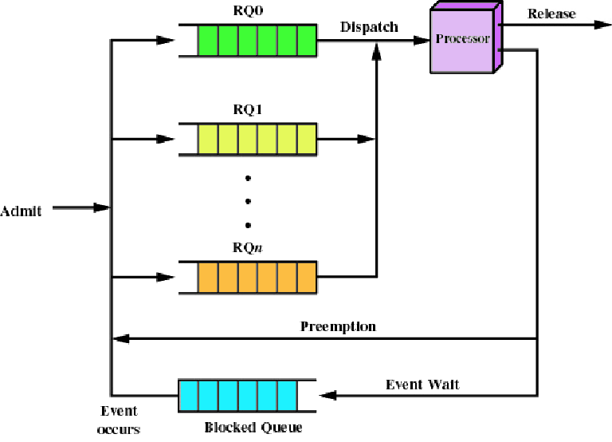
Priority Queuing
Mariusz Pelc © 2012/2013
(with support from Dr K. McManus and Dr C. Ierotheou)

Slide 13
Decision Modes
Nonpreemptive
Once a process is in the running state, it will continue until it terminates or blocks itself for I/O
Preemptive
Currently running process may be interrupted and moved to the Ready state by the operating system
Allows for better service since any one process cannot monopolize the processor for very long
Mariusz Pelc © 2012/2013
(with support from Dr K. McManus and Dr C. Ierotheou)

Slide 14
Scheduling examples – FCFS (First Come First Served)
Process | Arrival Time [ms] | Service Time [ms]
P1 | 0 | 25
P2 | 1 | 5
P3 | 2 | 4
0
10
20
30
40
Gannt’s Diagram
t[ms]
P1
P2
P2
P3
P3
Mariusz Pelc © 2012/2013
(with support from Dr K. McManus and Dr C. Ierotheou)

Slide 15
Scheduling examples – FCFS (First Come First Served)
Process | Arrival Time [ms] | Service Time [ms]
P1 | 2 | 25
P2 | 1 | 5
P3 | 0 | 4
0
10
20
30
40
Gannt’s Diagram
t[ms]
P3
P2
P2
P1
P1
Mariusz Pelc © 2012/2013
(with support from Dr K. McManus and Dr C. Ierotheou)

Slide 16
Scheduling examples – SJN (Shortest Job Next- Nonpreemptive)
Process | Arrival Time [ms] | Service Time [ms]
P1 | 0 | 8
P2 | 2 | 6
P3 | 4 | 4
P4 | 6 | 9
0
10
20
30
40
Gannt’s Diagram
t[ms]
P1
P2
P2
P3
P3
P4
P4
Mariusz Pelc © 2012/2013
(with support from Dr K. McManus and Dr C. Ierotheou)

Slide 17
Shortest Job Next
Predictability of longer processes is reduced
If estimated time for process not correct, the operating system may abort it
Possibility of starvation for longer processes
Mariusz Pelc © 2012/2013
(with support from Dr K. McManus and Dr C. Ierotheou)

Slide 18
Scheduling examples – SRT (Shortest Remaining Time)
Process | Arrival Time [ms] | Service Time [ms]
P1 | 0 | 8
P2 | 2 | 5
P3 | 4 | 4
P4 | 6 | 9
0
10
20
30
40
Gannt’s Diagram
t[ms]
P1
P1
P1
P2
P3
P3
P4
P4
Mariusz Pelc © 2012/2013
(with support from Dr K. McManus and Dr C. Ierotheou)

Slide 19
Highest Response Ratio Next
Highest Response Ratio Next (HRRN) scheduling is a non-preemptive discipline, similar to Shortest Job Next (SJN), in which the priority of each job is dependent on its estimated run time, and also the amount of time it has spent waiting. Jobs gain higher priority the longer they wait which prevents indefinite postponement (process starvation). In fact, the jobs that have spent a long time waiting compete against those which are estimated to have short run times.
where:
P – priority,
t – waiting time,
t – estimated run time
w
er
Mariusz Pelc © 2012/2013
(with support from Dr K. McManus and Dr C. Ierotheou)

Slide 20
Process run time
SPN, SRT and HRRN require either
prior knowledge of run time
good estimate of run time
It may be impossible or impractical to calculate the required process run time.
The following equation may be used in order to estimate the length of the next processor cycle:
Mariusz Pelc © 2012/2013
(with support from Dr K. McManus and Dr C. Ierotheou)

Slide 21
Round Robin
Round-Robin (RR) is one of the simplest scheduling algorithms for processes in an operating system, which assigns time slices to each process in equal portions and in circular order, handling all processes without priority. Round-robin scheduling is both simple and easy to implement, and starvation-free. Round-robin scheduling can also be applied to other scheduling problems, such as data packet scheduling in computer networks.
Mariusz Pelc © 2012/2013
(with support from Dr K. McManus and Dr C. Ierotheou)

Slide 22
Round Robin
Process | Arrival Time [ms] | Service Time [ms]
P1 | 0 | 8
P2 | 2 | 6
P3 | 4 | 4
P4 | 6 | 9
0
10
20
30
40
Gannt’s Diagram
t[ms]
Assuming time
quant = 2ms
P1
P1
P1
P1
P1
P1
P1
Exit
P2
P2
P2
P2
P2
Exit
P3
P3
P3
Exit
P4
P4
P4
P4
P4
P4
P4
Exit
Mariusz Pelc © 2012/2013
(with support from Dr K. McManus and Dr C. Ierotheou)

Slide 23
Round Robin – Influence of time quant on the number of context switches
Time quant | Context switches
12 | 0
6 | 1
1 | 9
Process time 10ms
0 10
0 6 10
0 1 2 3 4 5 6 7 8 9 10
Mariusz Pelc © 2012/2013
(with support from Dr K. McManus and Dr C. Ierotheou)

Slide 24
Scheduling Algorithms – which is the best?
Scheduling algorithm | CPU Utilization | Response Time | Deadline Handling | Throughput | Starvation Free
First In First Out | Low | High | High | Low | Yes
Shortest Remaining Time | Medium | Medium | Medium | High | No
Fixed Priority Pre-emptive Sch. | Medium | High | High | Low | No
Round Robin Scheduling | High | Low | Low | Medium | Yes
Mariusz Pelc © 2012/2013
(with support from Dr K. McManus and Dr C. Ierotheou)

Slide 25
Multilevel queues
System processes
Priority level
Interactive processes
Interactive editing processes
Batch processes
User processes
Mariusz Pelc © 2012/2013
(with support from Dr K. McManus and Dr C. Ierotheou)

Slide 26
Multilevel queues – Multilevel Feedback Scheduling
One process can be moved between various queues
If a process is using too much processor time it can be moved to a queue of lower priority
If a process is waiting too long it can be moved to a queue of higher priority (prevent starvation)
In case of multilevel queues it has to be specified:
- number of queues
- scheduling algorithm for each queue
- method used to move a process to a queue of higher priority
- method used to move a process to a queue of lower priority
Mariusz Pelc © 2012/2013
(with support from Dr K. McManus and Dr C. Ierotheou)

Slide 27
Multilevel queues – Multilevel Feedback Scheduling
RR - Time quant = 8 (higher priority)
RR - Time quant = 16 (lower priority)
FCFS
Mariusz Pelc © 2012/2013
(with support from Dr K. McManus and Dr C. Ierotheou)

Slide 28
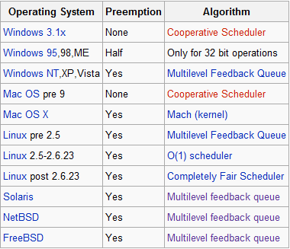
Schedulers in Real Operating Systems
Mariusz Pelc © 2012/2013
(with support from Dr K. McManus and Dr C. Ierotheou)

